Slide 1
Estimation
Week 4 Video 3
Dr Ric Crossman

Slide 2
Motivation

Slide 3
Motivation
Much of statistics involves finding estimates for population parameter values

Slide 4
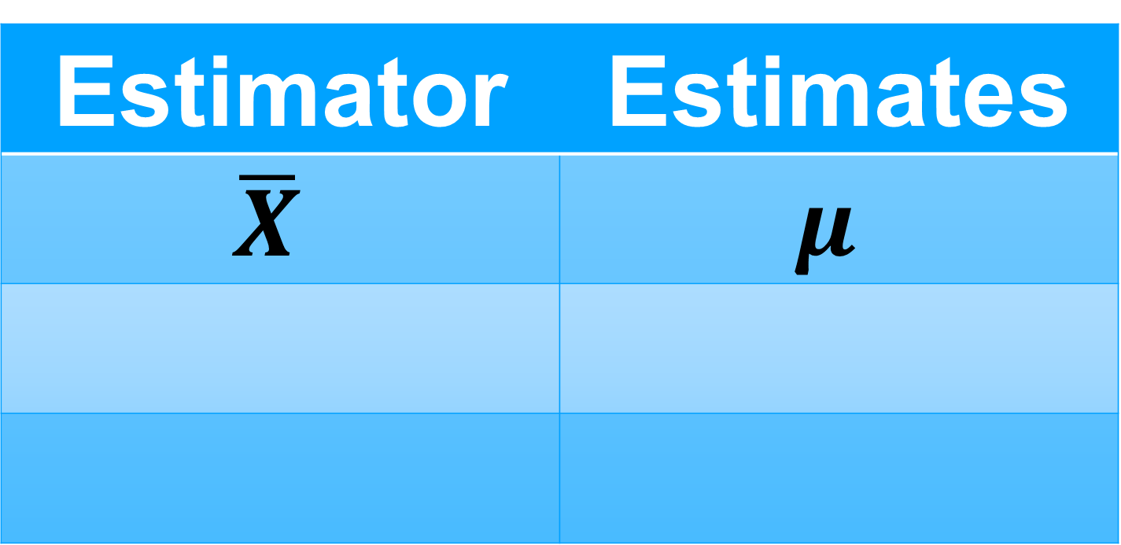
Motivation
Much of statistics involves finding estimates for population parameter values
E.g.:
Estimator | Estimates
$$\overline{X}$$ | $$μ$$

Slide 5
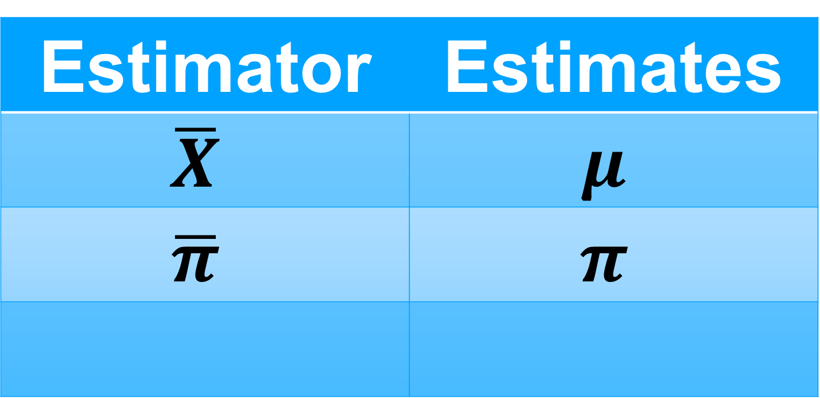
Motivation
Much of statistics involves finding estimates for population parameter values
E.g.:
Estimator | Estimates
$$\overline{X}$$ | $$μ$$
$$\overline{π}$$ | $$π$$

Slide 6
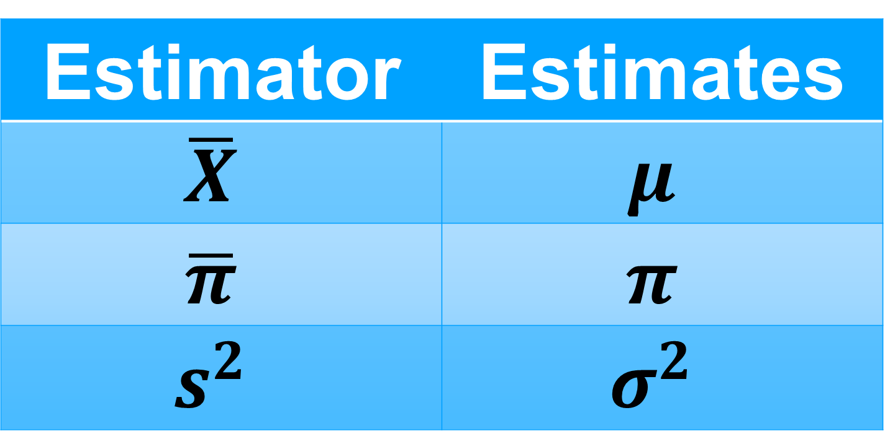
Motivation
Much of statistics involves finding estimates for population parameter values
E.g.:
Estimator | Estimates
$$\overline{X}$$ | $$μ$$
$$\overline{π}$$ | $$π$$
$$s^{2}$$ | $$σ^{2}$$

Slide 7
Motivation
Much of statistics involves finding estimates for population parameter values
E.g.:
Estimator | Estimates
$$\overline{X}$$ | $$μ$$
$$\overline{π}$$ | $$π$$
$$s^{2}$$ | $$σ^{2}$$
A sampling distribution is the distribution of an estimator

Slide 8
Types Of Estimation

Slide 9
Types Of Estimation
Point estimation: a single value, hopefully close a true parameter value

Slide 10
Types Of Estimation
Point estimation: a single value, hopefully close a true parameter value
What is difference between estimators and estimates?

Slide 11
Types Of Estimation
Point estimation: a single value, hopefully close a true parameter value
What is difference between estimators and estimates?
Interval estimation: an interval we hope contains a true parameter value

Slide 12
Types Of Estimation
Point estimation: a single value, hopefully close a true parameter value
What is difference between estimators and estimates?
Interval estimation: an interval we hope contains a true parameter value
How do we define/express that hope?

Slide 13
Learning Objectives

Slide 14
Learning Objectives
Explore difference between estimator and estimate

Slide 15
Learning Objectives
Explore difference between estimator and estimate
Generate interval estimates attached to mathematical measurement of “hope”

Slide 16
1) Estimators And Estimates

Slide 17
Estimators And Estimates

Slide 18
Estimators And Estimates
An estimator is a random variable

Slide 19
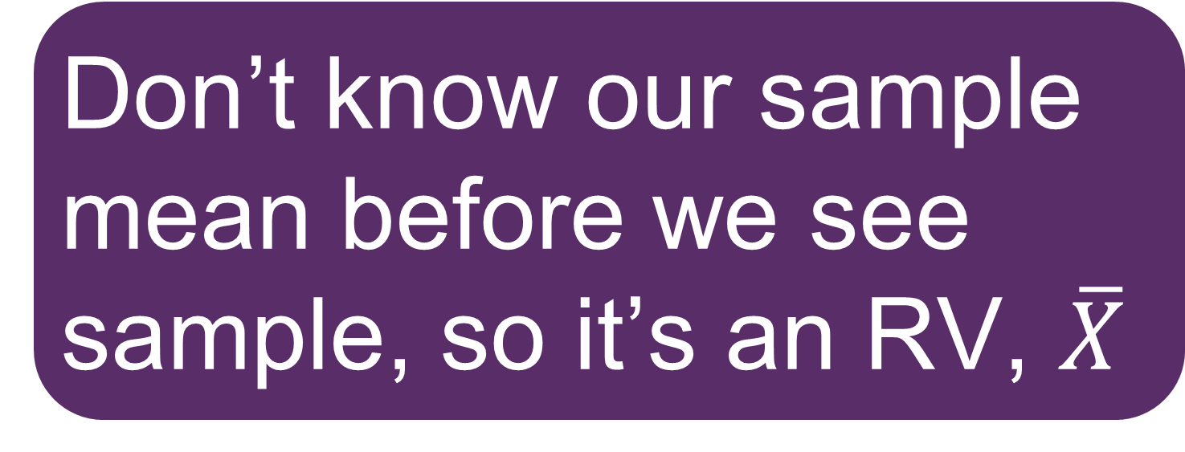
Estimators And Estimates
An estimator is a random variable
Don’t know our sample mean before we see sample, so it’s an RV, $\overline{X}$

Slide 20
Estimators And Estimates
An estimator is a random variable
Don’t know our sample mean before we see sample, so it’s an RV, $\overline{X}$
An estimate is a realisation of an estimator

Slide 21

Estimators And Estimates
An estimator is a random variable
Don’t know our sample mean before we see sample, so it’s an RV, $\overline{X}$
An estimate is a realisation of an estimator
Our estimate of $\overline{X}$ is $\overline{x}$

Slide 22
Estimators And Estimates
An estimator is a random variable
Estimators are processes
Don’t know our sample mean before we see sample, so it’s an RV, $\overline{X}$
An estimate is a realisation of an estimator
Our estimate of $\overline{X}$ is $\overline{x}$

Slide 23
Estimators And Estimates
An estimator is a random variable
Estimators are processes
Don’t know our sample mean before we see sample, so it’s an RV, $\overline{X}$
An estimate is a realisation of an estimator
Estimates are results of processes
Our estimate of $\overline{X}$ is $\overline{x}$

Slide 24
The Key Question

Slide 25
The Key Question
How far from the parameter value is an estimate likely to be?

Slide 26
The Key Question
How far from the parameter value is an estimate likely to be?
What is the variance of the sampling distribution of the estimator?

Slide 27
The Key Question
How far from the parameter value is an estimate likely to be?
What is the variance of the sampling distribution of the estimator?
Is our process affected by bias?

Slide 28
Bias (Informal Definition)

Slide 29
Bias (Informal Definition)
An estimator is unbiased if its expected value equals the value it estimates

Slide 30

Bias (Informal Definition)
An estimator is unbiased if its expected value equals the value it estimates
$$E\left(\overline{X}\right)=μ$$
Unbiased

Slide 31
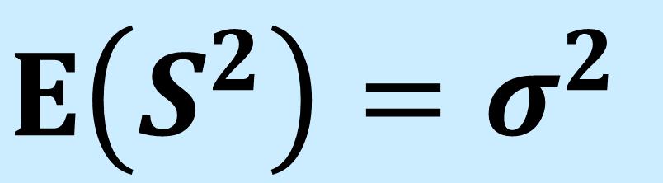
Bias (Informal Definition)
An estimator is unbiased if its expected value equals the value it estimates
$$E\left(\overline{X}\right)=μ$$
Unbiased
$$E\left(S^{2}\right)=σ^{2}$$
Unbiased

Slide 32
Bias (Informal Definition)
An estimator is unbiased if its expected value equals the value it estimates
$$E\left(\overline{X}\right)=μ$$
Unbiased
$$E\left(S^{2}\right)=σ^{2}$$
Unbiased
An estimator is biased if its expected value doesn’t equal the value it estimates

Slide 33
Bias (Informal Definition)
An estimator is unbiased if its expected value equals the value it estimates
$$E\left(\overline{X}\right)=μ$$
Unbiased
$$E\left(S^{2}\right)=σ^{2}$$
Unbiased
An estimator is biased if its expected value doesn’t equal the value it estimates
Bias = Expected estimator value
– true parameter value

Slide 34
New Notation

Slide 35

New Notation
Call parameter of interest $θ$

Slide 36

New Notation
Call parameter of interest $θ$
$θ$ might be e.g. $μ, π, σ^{2}$

Slide 37

New Notation
Call parameter of interest $θ$
$θ$ might be e.g. $μ, π, σ^{2}$
Call estimator of $θ$ we’re using $\hat{θ}$

Slide 38

New Notation
Call parameter of interest $θ$
$θ$ might be e.g. $μ, π, σ^{2}$
Call estimator of $θ$ we’re using $\hat{θ}$
Call set of values $θ$ can take the parameter space, $Θ$

Slide 39

New Notation
Call parameter of interest $θ$
$θ$ might be e.g. $μ, π, σ^{2}$
Call estimator of $θ$ we’re using $\hat{θ}$
Call set of values $θ$ can take the parameter space, $Θ$
For normal RV, $Θ$ for $μ$ is the real line

Slide 40

New Notation
Call parameter of interest $θ$
$θ$ might be e.g. $μ, π, σ^{2}$
Call estimator of $θ$ we’re using $\hat{θ}$
Call set of values $θ$ can take the parameter space, $Θ$
For normal RV, $Θ$ for $μ$ is the real line
For normal RV, $Θ$ for $σ^{2}$ is the +ve real line

Slide 41
Bias (Formal Definition)

Slide 42

Bias (Formal Definition)
Bias for estimator $\hat{θ}:$

Slide 43

Bias (Formal Definition)
Bias for estimator $\hat{θ}:$
$$Bias\left(\hat{θ}\right)=E\left(\hat{θ}\right)−θ$$

Slide 44

Bias (Formal Definition)
Bias for estimator $\hat{θ}:$
$$Bias\left(\hat{θ}\right)=E\left(\hat{θ}\right)−θ$$
Bias for unbiased $\hat{θ}=0$

Slide 45
Bias (Formal Definition)
Bias for estimator $\hat{θ}:$
$$Bias\left(\hat{θ}\right)=E\left(\hat{θ}\right)−θ$$
Bias for unbiased $\hat{θ}=0$
Bias is a structural problem

Slide 46
Bias (Formal Definition)
Bias for estimator $\hat{θ}:$
$$Bias\left(\hat{θ}\right)=E\left(\hat{θ}\right)−θ$$
Bias for unbiased $\hat{θ}=0$
Bias is a structural problem
Positive bias – estimator prone to overestimate

Slide 47
Bias (Formal Definition)
Bias for estimator $\hat{θ}:$
$$Bias\left(\hat{θ}\right)=E\left(\hat{θ}\right)−θ$$
Bias for unbiased $\hat{θ}=0$
Bias is a structural problem
Negative bias – estimator prone to underestimate

Slide 48
Mean Squared Error

Slide 49
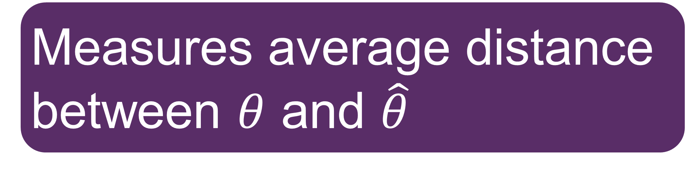
Mean Squared Error
Measures average distance between $θ$ and $\hat{θ}$

Slide 50
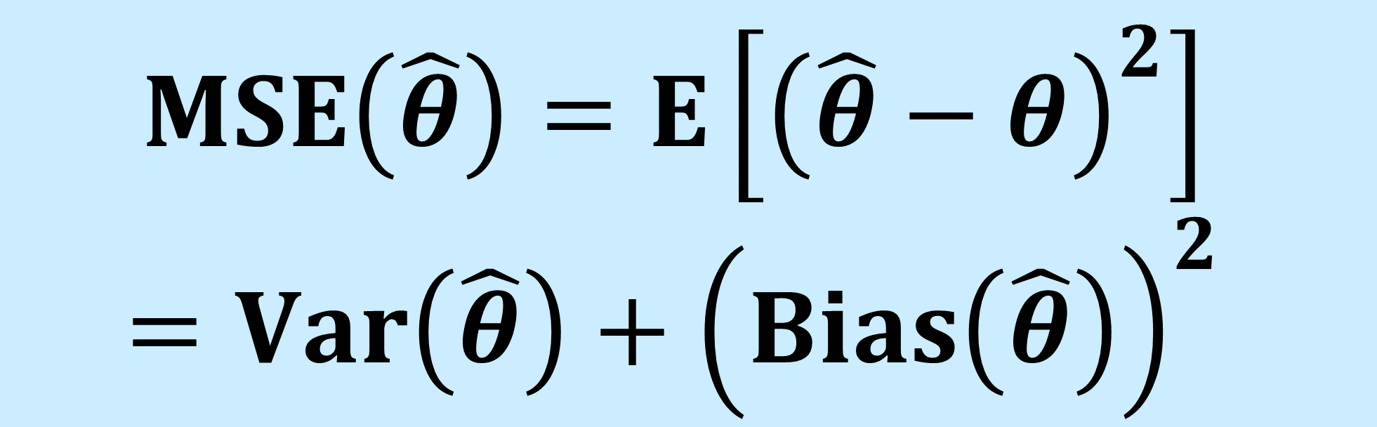
Mean Squared Error
Measures average distance between $θ$ and $\hat{θ}$
$$MSE\left(\hat{θ}\right)=E\left[{\left(\hat{θ}−θ\right)}^{2}\right]$$
$$=Var\left(\hat{θ}\right)+{\left(Bias\left(\hat{θ}\right)\right)}^{2}$$

Slide 51
Mean Squared Error
Measures average distance between $θ$ and $\hat{θ}$
$$MSE\left(\hat{θ}\right)=E\left[{\left(\hat{θ}−θ\right)}^{2}\right]$$
$$=Var\left(\hat{θ}\right)+{\left(Bias\left(\hat{θ}\right)\right)}^{2}$$

Slide 52
Mean Squared Error
Measures average distance between $θ$ and $\hat{θ}$
$$MSE\left(\hat{θ}\right)=E\left[{\left(\hat{θ}−θ\right)}^{2}\right]$$
$$=Var\left(\hat{θ}\right)+{\left(Bias\left(\hat{θ}\right)\right)}^{2}$$
Equals sampling variance when estimator is unbiased

Slide 53
2) Interval Estimation

Slide 54
Useful Intervals

Slide 55
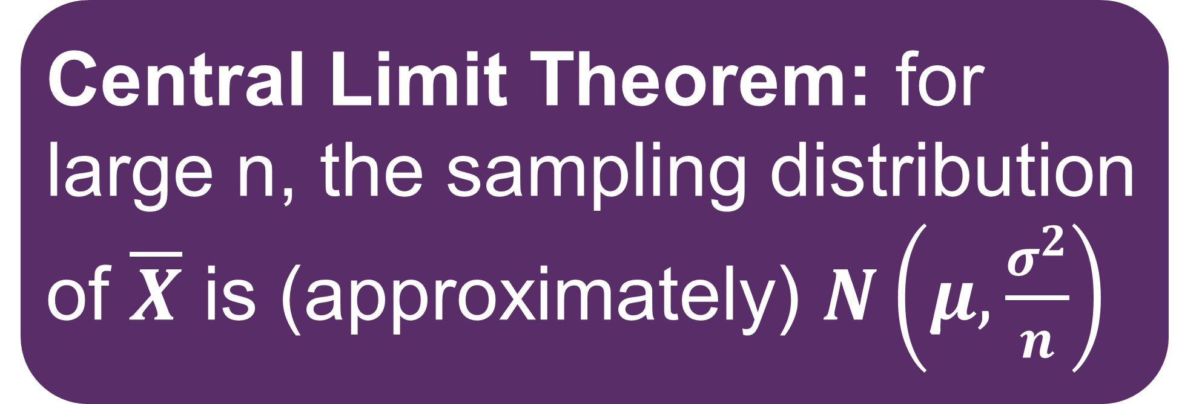
Useful Intervals
Central Limit Theorem: for large n, the sampling distribution of $\overline{X}$ is (approximately) $N\left(μ,\frac{σ^{2}}{n}\right)$

Slide 56
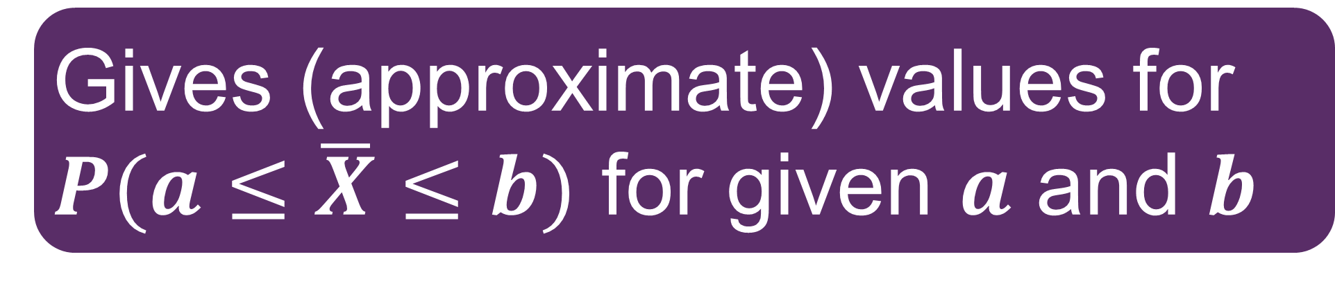
Useful Intervals
Central Limit Theorem: for large n, the sampling distribution of $\overline{X}$ is (approximately) $N\left(μ,\frac{σ^{2}}{n}\right)$
Gives (approximate) values for $P(a≤\overline{X}≤b)$ for given $a$ and $b$

Slide 57
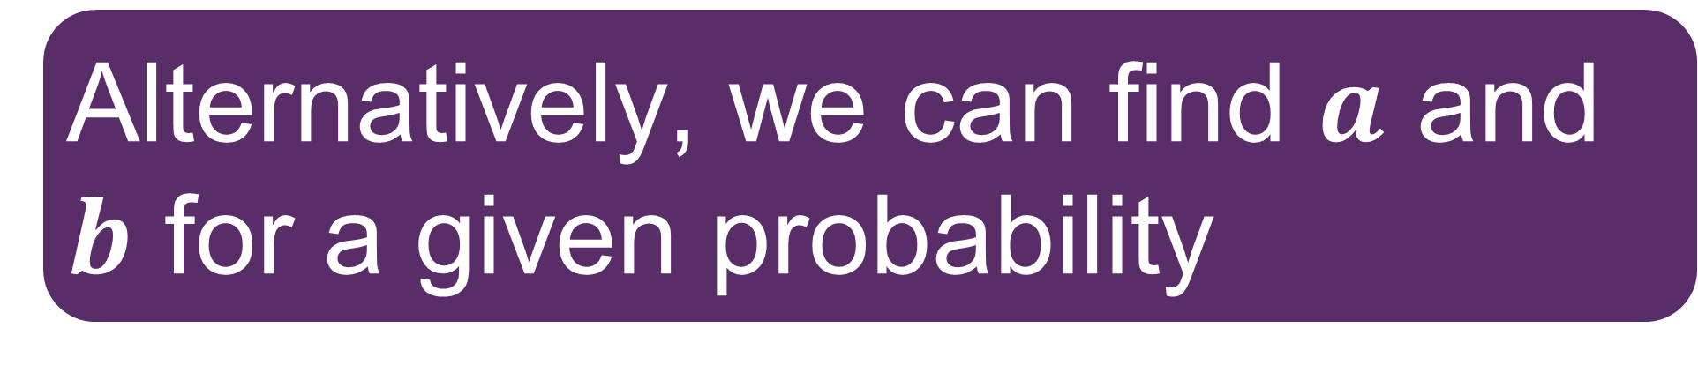
Useful Intervals
Central Limit Theorem: for large n, the sampling distribution of $\overline{X}$ is (approximately) $N\left(μ,\frac{σ^{2}}{n}\right)$
Gives (approximate) values for $P(a≤\overline{X}≤b)$ for given $a$ and $b$
Alternatively, we can find $a$ and $b$ for a given probability

Slide 58

Useful Intervals
Central Limit Theorem: for large n, the sampling distribution of $\overline{X}$ is (approximately) $N\left(μ,\frac{σ^{2}}{n}\right)$
Gives (approximate) values for $P(a≤\overline{X}≤b)$ for given $a$ and $b$
Alternatively, we can find $a$ and $b$ for a given probability
Usually assume $\overline{X}−a=b−\overline{X}$

Slide 59
Building An Interval

Slide 60
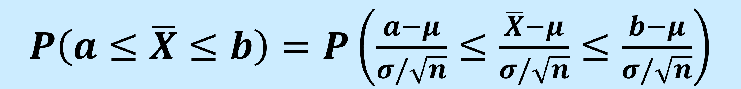
Building An Interval
$P\left(a≤\overline{X}≤b\right)=$ $P\left(\frac{a−μ}{σ/\sqrt{n}}≤\frac{\overline{X}−μ}{σ/\sqrt{n}}≤\frac{b−μ}{σ/\sqrt{n}}\right)$

Slide 61
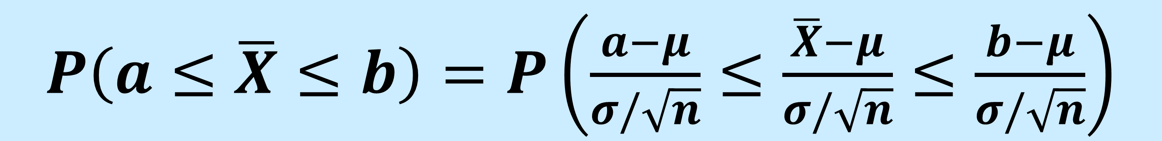
Building An Interval
$P\left(a≤\overline{X}≤b\right)=$ $P\left(\frac{a−μ}{σ/\sqrt{n}}≤\frac{\overline{X}−μ}{σ/\sqrt{n}}≤\frac{b−μ}{σ/\sqrt{n}}\right)$
$P\left(a≤\overline{X}≤b\right)=$ $P\left(\frac{a−μ}{σ/\sqrt{n}}≤\frac{\overline{X}−μ}{σ/\sqrt{n}}≤\frac{b−μ}{σ/\sqrt{n}}\right)$

Slide 62
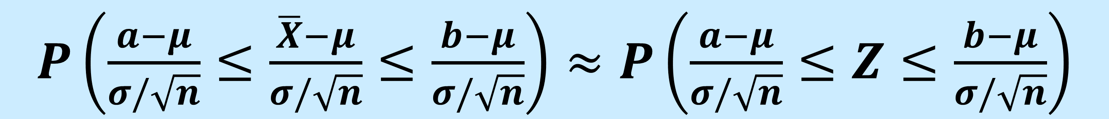

Building An Interval
$P\left(a≤\overline{X}≤b\right)=$ $P\left(\frac{a−μ}{σ/\sqrt{n}}≤\frac{\overline{X}−μ}{σ/\sqrt{n}}≤\frac{b−μ}{σ/\sqrt{n}}\right)$
$P\left(a≤\overline{X}≤b\right)=$ $P\left(\frac{a−μ}{σ/\sqrt{n}}≤\frac{\overline{X}−μ}{σ/\sqrt{n}}≤\frac{b−μ}{σ/\sqrt{n}}\right)$
n$≥30$
$P\left(\frac{a−μ}{σ/\sqrt{n}}≤\frac{\overline{X}−μ}{σ/\sqrt{n}}≤\frac{b−μ}{σ/\sqrt{n}}\right)≈$ $P\left(\frac{a−μ}{σ/\sqrt{n}}≤Z≤\frac{b−μ}{σ/\sqrt{n}}\right)$

Slide 63


Building An Interval
For a probability $p$<1, must be a $c$ for which:
$$P\left(−c≤Z≤c\right)=p$$

Slide 64

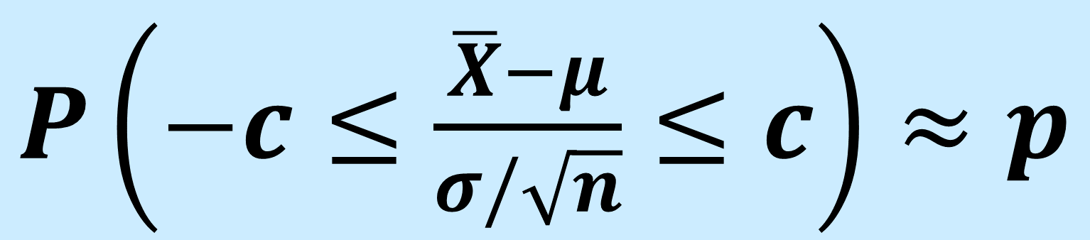
Building An Interval
For a probability $p$<1, must be a $c$ for which:
$$P\left(−c≤Z≤c\right)=p$$
$P\left(−c≤\frac{\overline{X}−μ}{σ/\sqrt{n}}≤c\right)≈$ $p$
n$≥30$

Slide 65
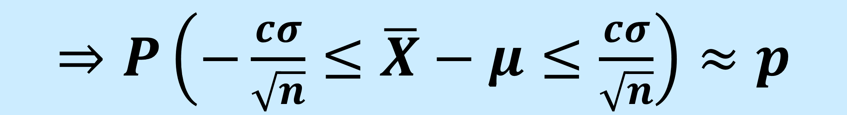
Building An Interval
For a probability $p$<1, must be a $c$ for which:
$$P\left(−c≤Z≤c\right)=p$$
$P\left(−c≤\frac{\overline{X}−μ}{σ/\sqrt{n}}≤c\right)≈$ $p$
n$≥30$
$⇒P\left(−\frac{cσ}{\sqrt{n}}≤\overline{X}−μ≤\frac{cσ}{\sqrt{n}}\right)≈$ $p$

Slide 66
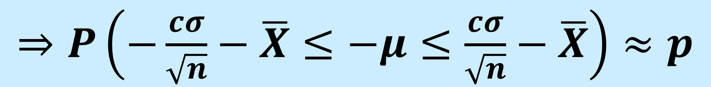
Building An Interval
For a probability $p$<1, must be a $c$ for which:
$$P\left(−c≤Z≤c\right)=p$$
$P\left(−c≤\frac{\overline{X}−μ}{σ/\sqrt{n}}≤c\right)≈$ $p$
n$≥30$
$⇒P\left(−\frac{cσ}{\sqrt{n}}≤\overline{X}−μ≤\frac{cσ}{\sqrt{n}}\right)≈$ $p$
$⇒P\left(−\frac{cσ}{\sqrt{n}}−\overline{X}≤−μ≤\frac{cσ}{\sqrt{n}}−\overline{X}\right)≈$ $p$

Slide 67

Building An Interval
For a probability $p$<1, must be a $c$ for which:
$$P\left(−c≤Z≤c\right)=p$$
$P\left(−c≤\frac{\overline{X}−μ}{σ/\sqrt{n}}≤c\right)≈$ $p$
n$≥30$
$⇒P\left(−\frac{cσ}{\sqrt{n}}≤\overline{X}−μ≤\frac{cσ}{\sqrt{n}}\right)≈$ $p$
$⇒P\left(−\frac{cσ}{\sqrt{n}}−\overline{X}≤−μ≤\frac{cσ}{\sqrt{n}}−\overline{X}\right)≈$ $p$
$⇒P\left(\frac{cσ}{\sqrt{n}}+\overline{X}≥μ≥\overline{X}−\frac{cσ}{\sqrt{n}}\right)≈$ $p$

Slide 68

The Interval Estimate
$P\left(\overline{X}−\frac{cσ}{\sqrt{n}}≤μ≤\overline{X}+\frac{cσ}{\sqrt{n}}\right)≈$ $p$
Four points to make about our interval estimate

Slide 69

The Interval Estimate
$P\left(\overline{X}−\frac{cσ}{\sqrt{n}}≤μ≤\overline{X}+\frac{cσ}{\sqrt{n}}\right)≈$ $p$
Four points to make about our interval estimate
Point 1
$μ$ and $σ$ are fixed values, but n gets larger as we collect more data

Slide 70
The Interval Estimate
$P\left(\overline{X}−\frac{cσ}{\sqrt{n}}≤μ≤\overline{X}+\frac{cσ}{\sqrt{n}}\right)≈$ $p$
Four points to make about our interval estimate
Point 1
$μ$ and $σ$ are fixed values, but n gets larger as we collect more data
Larger n means narrower interval

Slide 71
The Interval Estimate
$P\left(\overline{X}−\frac{cσ}{\sqrt{n}}≤μ≤\overline{X}+\frac{cσ}{\sqrt{n}}\right)≈$ $p$
Four points to make about our interval estimate
Point 1
$μ$ and $σ$ are fixed values, but n gets larger as we collect more data
Larger n means narrower interval
More information means greater confidence we are close to the truth!

Slide 72
The Interval Estimate
CONFIDENCE INTERVAL
$P\left(\overline{X}−\frac{cσ}{\sqrt{n}}≤μ≤\overline{X}+\frac{cσ}{\sqrt{n}}\right)≈$ $p$
Four points to make about our interval estimate
Point 1
$μ$ and $σ$ are fixed values, but n gets larger as we collect more data
Larger n means narrower interval
More information means greater confidence we are close to the truth!

Slide 73
The Confidence Interval
$P\left(\overline{X}−\frac{cσ}{\sqrt{n}}≤μ≤\overline{X}+\frac{cσ}{\sqrt{n}}\right)≈$ $p$
Point 2

Slide 74

The Confidence Interval
$P\left(\overline{X}−\frac{cσ}{\sqrt{n}}≤μ≤\overline{X}+\frac{cσ}{\sqrt{n}}\right)≈$ $p$
Point 2
Need to know the value of $c$

Slide 75
The Confidence Interval
$P\left(\overline{X}−\frac{cσ}{\sqrt{n}}≤μ≤\overline{X}+\frac{cσ}{\sqrt{n}}\right)≈$ $p$
Point 2
Need to know the value of $c$
Get it from standard normal tables

Slide 76
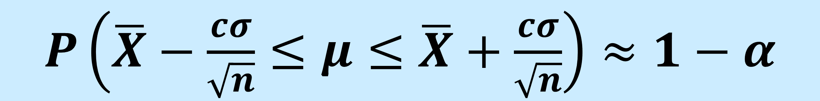
The Confidence Interval
$P\left(\overline{X}−\frac{cσ}{\sqrt{n}}≤μ≤\overline{X}+\frac{cσ}{\sqrt{n}}\right)≈$ $1−α$
Point 2
Need to know the value of $c$
Get it from standard normal tables

Slide 77
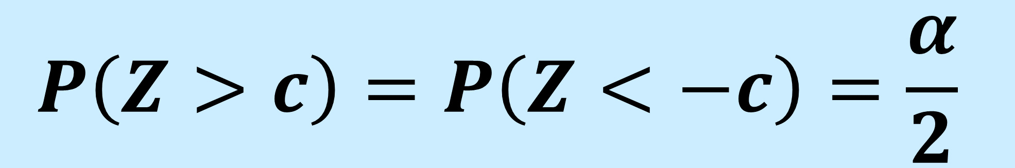
The Confidence Interval
$P\left(\overline{X}−\frac{cσ}{\sqrt{n}}≤μ≤\overline{X}+\frac{cσ}{\sqrt{n}}\right)≈$ $1−α$
Point 2
Need to know the value of $c$
Get it from standard normal tables
$$P\left(Z>c\right)=P\left(Z<−c\right)=\frac{α}{2}$$

Slide 78

The Confidence Interval
$P\left(\overline{X}−\frac{cσ}{\sqrt{n}}≤μ≤\overline{X}+\frac{cσ}{\sqrt{n}}\right)≈$ $1−α$
Point 2
Need to know the value of $c$
Get it from standard normal tables
$$P\left(Z>c\right)=P\left(Z<−c\right)=\frac{α}{2}$$
Call $c$ the critical value, $z_{α/2}$

Slide 79
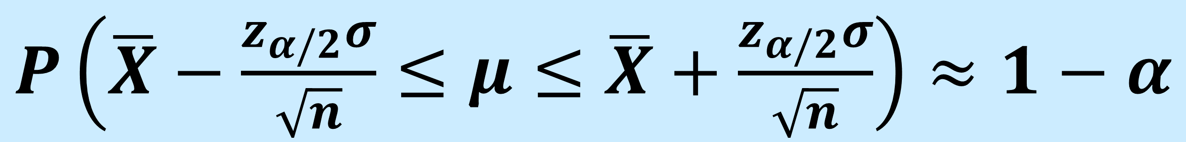
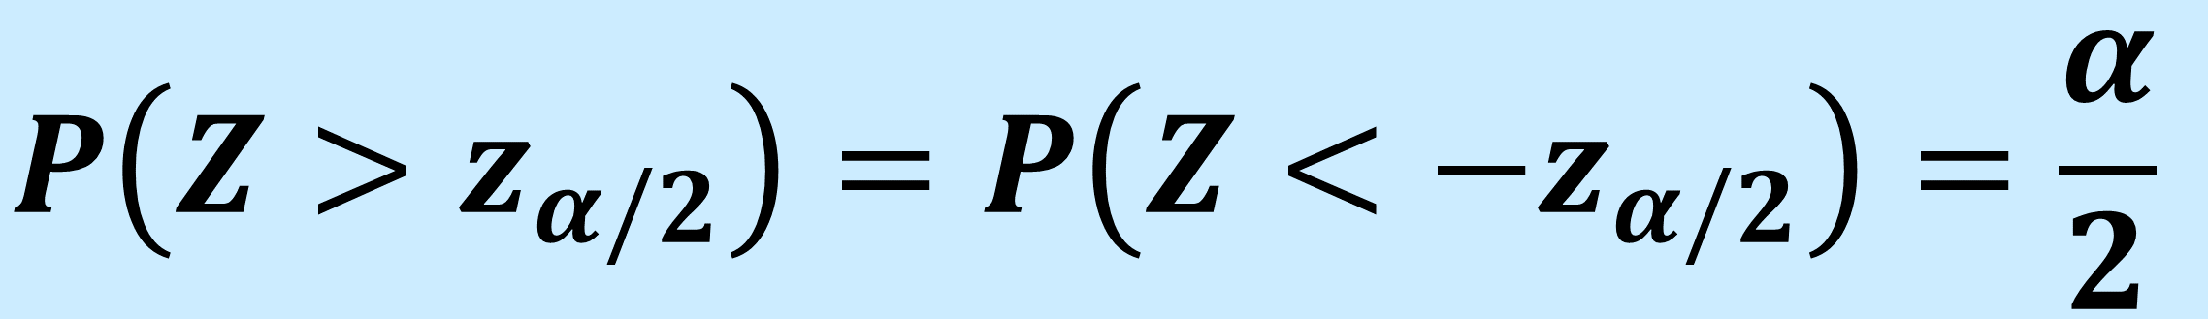
The Confidence Interval
$P\left(\overline{X}−\frac{z_{α/2}σ}{\sqrt{n}}≤μ≤\overline{X}+\frac{z_{α/2}σ}{\sqrt{n}}\right)≈$ $1−α$
Point 2
Need to know the value of $c$
Get it from standard normal tables
$$P\left(Z>z_{α/2}\right)=P\left(Z<−z_{α/2}\right)=\frac{α}{2}$$
Call $c$ the critical value, $z_{α/2}$

Slide 80
95% Confidence Interval

Slide 81

95% Confidence Interval
Very common to use $1−α=0.95$

Slide 82

95% Confidence Interval
Very common to use $1−α=0.95$
$$z_{0.025}=1.96$$

Slide 83

95% Confidence Interval
Very common to use $1−α=0.95$
$$z_{0.025}=1.96$$
$$P\left(Z>1.96\right)=0.025$$

Slide 84
95% Confidence Interval
Very common to use $1−α=0.95$
$$z_{0.025}=1.96$$
$$P\left(Z>1.96\right)=0.025$$
Call this the 95% confidence interval

Slide 85
The Confidence Interval
$P\left(\overline{X}−\frac{z_{α/2}σ}{\sqrt{n}}≤μ≤\overline{X}+\frac{z_{α/2}σ}{\sqrt{n}}\right)≈$ $1−α$
Point 3

Slide 86

The Confidence Interval
$P\left(\overline{X}−\frac{z_{α/2}σ}{\sqrt{n}}≤μ≤\overline{X}+\frac{z_{α/2}σ}{\sqrt{n}}\right)≈$ $1−α$
Point 3
Can’t find interval without $σ$, which we usually don’t know!

Slide 87

The Confidence Interval
$P\left(\overline{X}−\frac{z_{α/2}σ}{\sqrt{n}}≤μ≤\overline{X}+\frac{z_{α/2}σ}{\sqrt{n}}\right)≈$ $1−α$
Point 3
Can’t find interval without $σ$, which we usually don’t know!
Remember: $S^{2}$ is an unbiased estimator

Slide 88

The Confidence Interval
$P\left(\overline{X}−\frac{z_{α/2}σ}{\sqrt{n}}≤μ≤\overline{X}+\frac{z_{α/2}σ}{\sqrt{n}}\right)≈$ $1−α$
Point 3
Can’t find interval without $σ$, which we usually don’t know!
Remember: $S^{2}$ is an unbiased estimator
When $n≥30$, : $S^{2}$ is an accurate estimator

Slide 89


The Confidence Interval
$P\left(\overline{X}−\frac{z_{α/2}σ}{\sqrt{n}}≤μ≤\overline{X}+\frac{z_{α/2}σ}{\sqrt{n}}\right)≈$ $1−α$
Point 3
Can’t find interval without $σ$, which we usually don’t know!
Remember: $S^{2}$ is an unbiased estimator
When $n≥30$, $S^{2}$ is an accurate estimator
So replace $σ with$ $s$

Slide 90
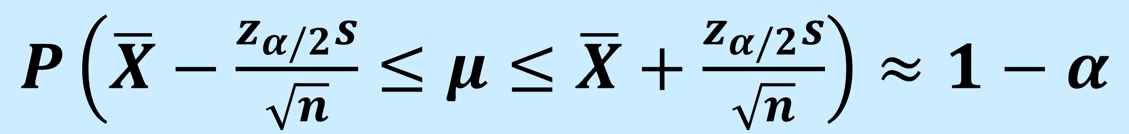
The Confidence Interval
$P\left(\overline{X}−\frac{z_{α/2}s}{\sqrt{n}}≤μ≤\overline{X}+\frac{z_{α/2}s}{\sqrt{n}}\right)≈$ $1−α$
Point 3
Can’t find interval without $σ$, which we usually don’t know!
Remember: $S^{2}$ is an unbiased estimator
When $n≥30$, : $S^{2}$ is an accurate estimator
So replace $σ with$ $s$

Slide 91
The Confidence Interval
$P\left(\overline{X}−\frac{z_{α/2}s}{\sqrt{n}}≤μ≤\overline{X}+\frac{z_{α/2}s}{\sqrt{n}}\right)≈$ $1−α$
Point 3
Standard Error
Can’t find interval without $σ$, which we usually don’t know!
Remember: $S^{2}$ is an unbiased estimator
When $n≥30$, : $S^{2}$ is an accurate estimator
So replace $σ with$ $s$

Slide 92
100$\left(1−α\right)$% Confidence Interval

Slide 93

100$\left(1−α\right)$% Confidence Interval
Can now calculate a 100$(1−α)$% confidence interval (CI)

Slide 94

100$\left(1−α\right)$% Confidence Interval
Can now calculate a 100$(1−α)$% confidence interval (CI)
Most often use 95% CI, $z_{0.025}=1.96$

Slide 95

100$\left(1−α\right)$% Confidence Interval
Can now calculate a 100$(1−α)$% confidence interval (CI)
Most often use 95% CI, $z_{0.025}=1.96$
Sometimes use 99% CI, $z_{0.005}=2.58$

Slide 96

100$\left(1−α\right)$% Confidence Interval
Can now calculate a 100$(1−α)$% confidence interval (CI)
Most often use 95% CI, $z_{0.025}=1.96$
Sometimes use 99% CI, $z_{0.005}=2.58$
Since $2.58>1.96$, 99% CI is wider than 95% CI

Slide 97

100$\left(1−α\right)$% Confidence Interval
Can now calculate a 100$(1−α)$% confidence interval (CI)
Most often use 95% CI, $z_{0.025}=1.96$
Sometimes use 99% CI, $z_{0.005}=2.58$
Since $2.58>1.96$, 99% CI is wider than 95% CI
Make sense? Need a wider interval to have more confidence we captured $μ$

Slide 98
Interpreting A Confidence Interval
$P\left(\overline{X}−\frac{z_{α/2}s}{\sqrt{n}}≤μ≤\overline{X}+\frac{z_{α/2}s}{\sqrt{n}}\right)≈$ $1−α$
Point 4

Slide 99
Interpreting A Confidence Interval
$P\left(\overline{X}−\frac{z_{α/2}s}{\sqrt{n}}≤μ≤\overline{X}+\frac{z_{α/2}s}{\sqrt{n}}\right)≈$ $1−α$
Point 4
What does the probability here mean?

Slide 100

Interpreting A Confidence Interval
$P\left(\overline{X}−\frac{z_{α/2}s}{\sqrt{n}}≤μ≤\overline{X}+\frac{z_{α/2}s}{\sqrt{n}}\right)≈$ $1−α$
Point 4
What does the probability here mean?
Interpretation 1: 0.95 probability $μ$ is in a 95% CI

Slide 101
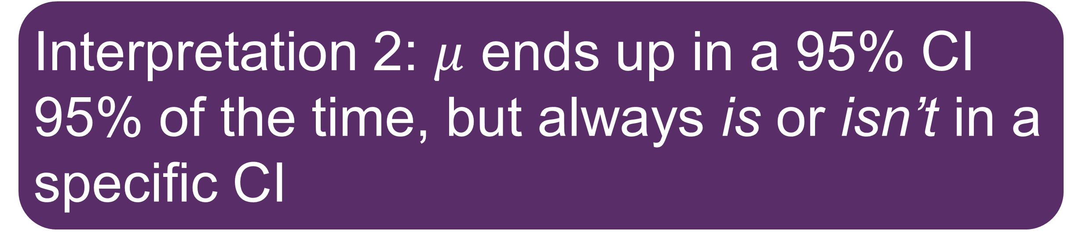
Interpreting A Confidence Interval
$P\left(\overline{X}−\frac{z_{α/2}s}{\sqrt{n}}≤μ≤\overline{X}+\frac{z_{α/2}s}{\sqrt{n}}\right)≈$ $1−α$
Point 4
What does the probability here mean?
Interpretation 1: 0.95 probability $μ$ is in a 95% CI
Interpretation 2: $μ$ ends up in a 95% CI 95% of the time, but always is or isn’t in a specific CI

Slide 102
Interpreting A Confidence Interval
$P\left(\overline{X}−\frac{z_{α/2}s}{\sqrt{n}}≤μ≤\overline{X}+\frac{z_{α/2}s}{\sqrt{n}}\right)≈$ $1−α$
Point 4
What does the probability here mean?
Interpretation 1: 0.95 probability $μ$ is in a 95% CI
?
Interpretation 2: $μ$ ends up in a 95% CI 95% of the time, but always is or isn’t in a specific CI

Slide 103
Interpreting A Confidence Interval
$P\left(\overline{X}−\frac{z_{α/2}s}{\sqrt{n}}≤μ≤\overline{X}+\frac{z_{α/2}s}{\sqrt{n}}\right)≈$ $1−α$
Point 4
Depends where we are in the process

Slide 104
Interpreting A Confidence Interval
$P\left(\overline{X}−\frac{z_{α/2}s}{\sqrt{n}}≤μ≤\overline{X}+\frac{z_{α/2}s}{\sqrt{n}}\right)≈$ $1−α$
Estimators
Point 4
Depends where we are in the process

Slide 105
Interpreting A Confidence Interval
$P\left(\overline{X}−\frac{z_{α/2}s}{\sqrt{n}}≤μ≤\overline{X}+\frac{z_{α/2}s}{\sqrt{n}}\right)≈$ $1−α$
Estimators
Point 4
Depends where we are in the process
Before data, CI is two estimators, each with a sampling distribution => Probabilities!

Slide 106
Interpreting A Confidence Interval
$P\left(\overline{X}−\frac{z_{α/2}s}{\sqrt{n}}≤μ≤\overline{X}+\frac{z_{α/2}s}{\sqrt{n}}\right)≈$ $1−α$
Estimators
Point 4
Depends where we are in the process
Before data, CI is two estimators, each with a sampling distribution => Probabilities!
After data, CI is two of estimates, specific realisations of RVs => No probabilities!

Slide 107
Interpreting A Confidence Interval
$P\left(\overline{X}−\frac{z_{α/2}s}{\sqrt{n}}≤μ≤\overline{X}+\frac{z_{α/2}s}{\sqrt{n}}\right)≈$ $1−α$
Estimators
Point 4
The process of finding a CI has a probability attached to it
A CI you calculate by following the process does not

Slide 108
Summary

Slide 109
Summary
To build a confidence interval, we need:

Slide 110
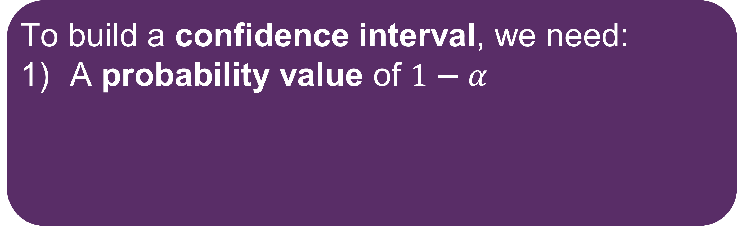
Summary
To build a confidence interval, we need:
A probability value of $1−α$

Slide 111
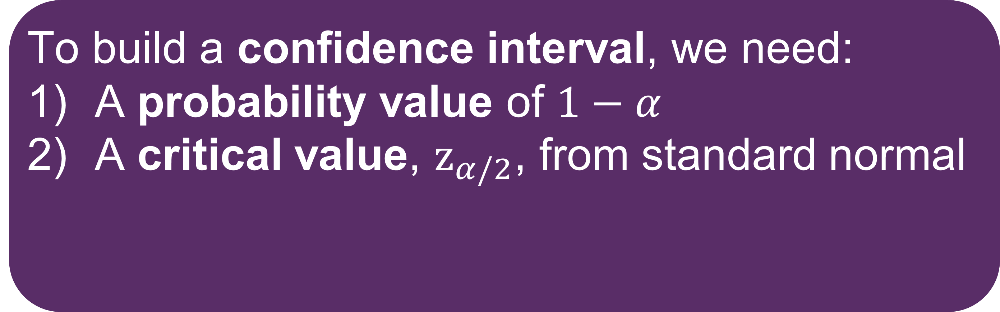
Summary
To build a confidence interval, we need:
A probability value of $1−α$
A critical value, $z_{α/2}$, from standard normal

Slide 112
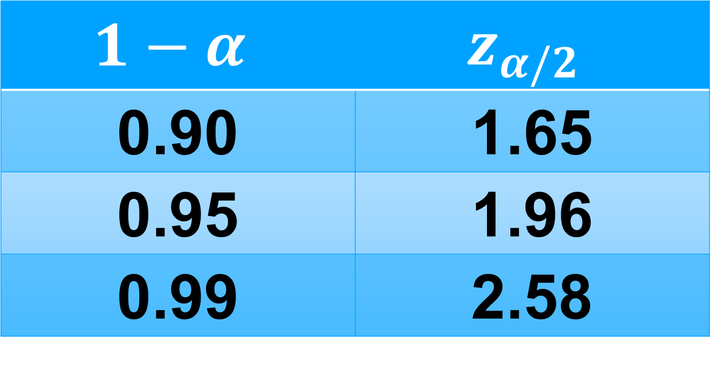
Summary
To build a confidence interval, we need:
A probability value of $1−α$
A critical value, $z_{α/2}$, from standard normal
$$1−α$$ | $$z_{α/2}$$
0.90 | 1.65
0.95 | 1.96
0.99 | 2.58

Slide 113
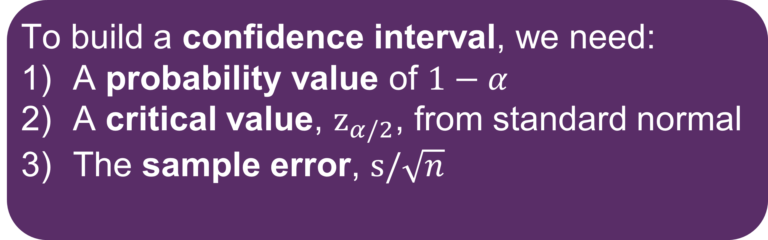
Summary
To build a confidence interval, we need:
A probability value of $1−α$
A critical value, $z_{α/2}$, from standard normal
The sample error, $s/\sqrt{n}$
$$1−α$$ | $$z_{α/2}$$
0.90 | 1.65
0.95 | 1.96
0.99 | 2.58

Slide 114
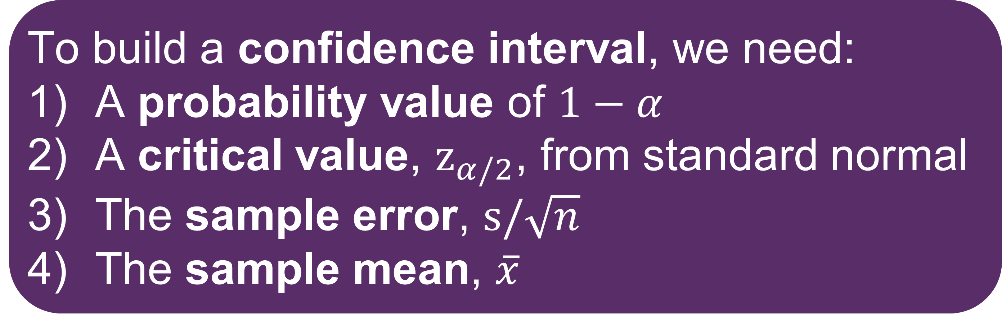
Summary
To build a confidence interval, we need:
A probability value of $1−α$
A critical value, $z_{α/2}$, from standard normal
The sample error, $s/\sqrt{n}$
The sample mean, $\overline{x}$
$$1−α$$ | $$z_{α/2}$$
0.90 | 1.65
0.95 | 1.96
0.99 | 2.58

Slide 115
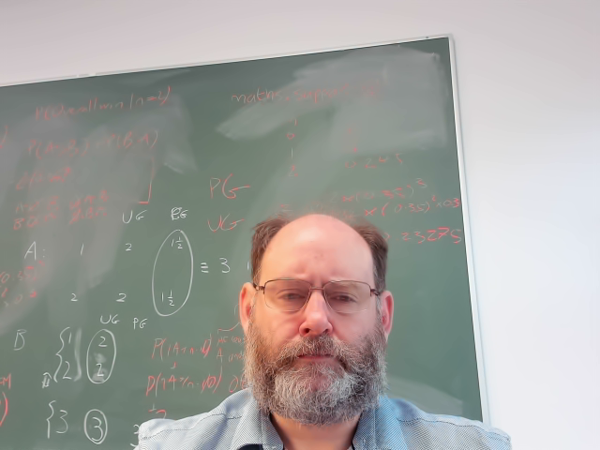

CIs When Sampling From A Normal Distribution
When $X$~N($μ, σ^{2}$)

Slide 116
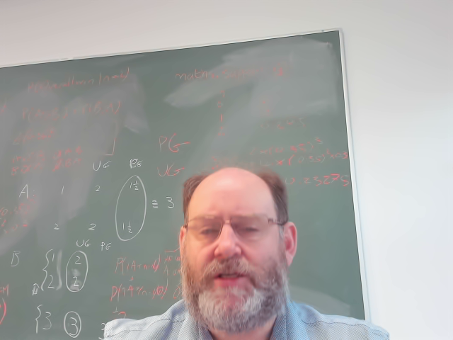

CIs When Sampling From A Normal Distribution
When $X$~N($μ, σ^{2}$)
$\overline{X}$~N$\left(μ,\frac{σ^{2}}{n}\right)$ no matter how small $n$ is

Slide 117
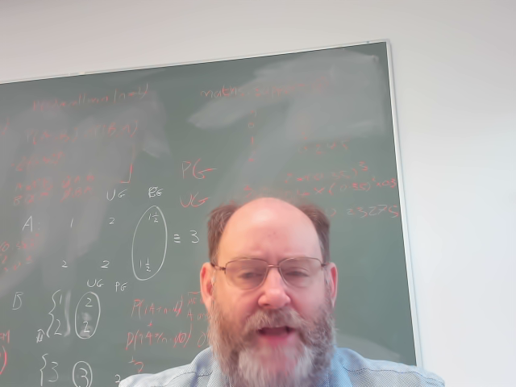

CIs When Sampling From A Normal Distribution
When $X$~N($μ, σ^{2}$)
$\overline{X}$~N$\left(μ,\frac{σ^{2}}{n}\right)$ no matter how small $n$ is
But $n<30$ means $s$ not a good estimator for $σ$

Slide 118
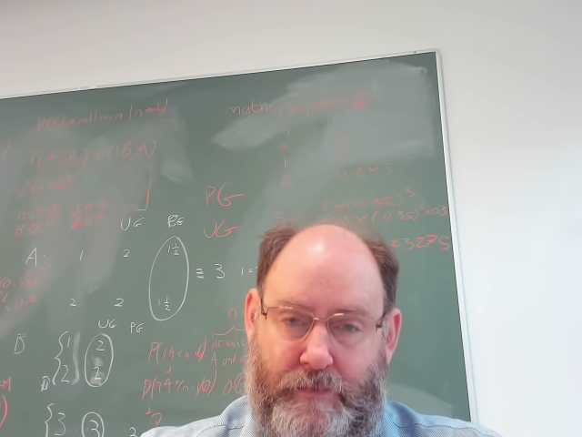
CIs When Sampling From A Normal Distribution
When $X$~N($μ, σ^{2}$)
$\overline{X}$~N$\left(μ,\frac{σ^{2}}{n}\right)$ no matter how small $n$ is
But $n<30$ means $s$ not a good estimator for $σ$
Recall: introduced t-distribution in Vid 4.1
Similar to standard normal, but more robust

Slide 119
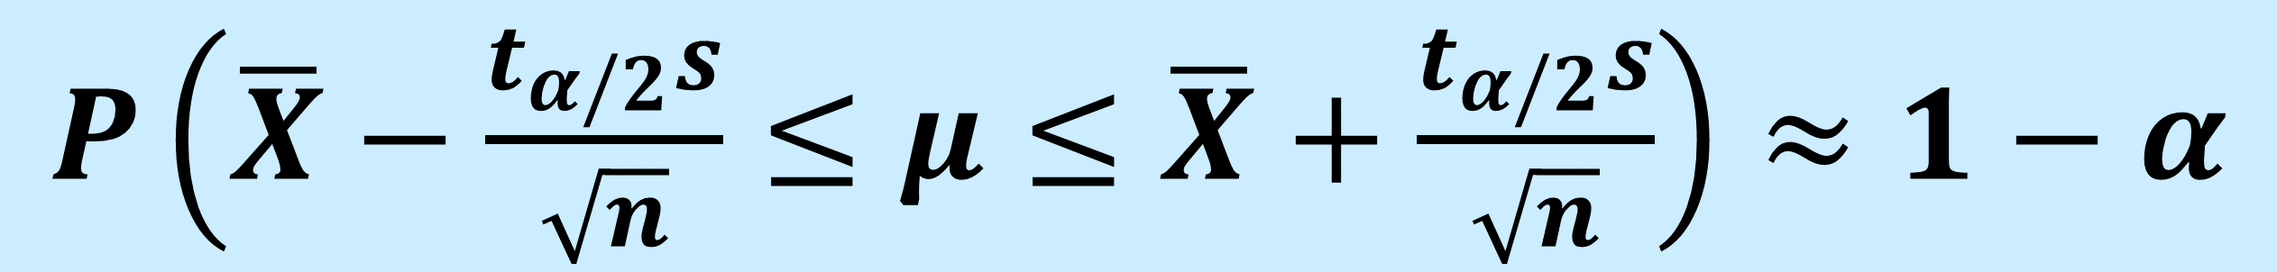

CIs When Sampling From A Normal Distribution
When $X$~N($μ, σ^{2}$)
When $n<30$
$P\left(\overline{X}−\frac{t_{α/2}s}{\sqrt{n}}≤μ≤\overline{X}+\frac{t_{α/2}s}{\sqrt{n}}\right)≈$ $1−α$

Slide 120
CIs For Sample Proportion

Slide 121
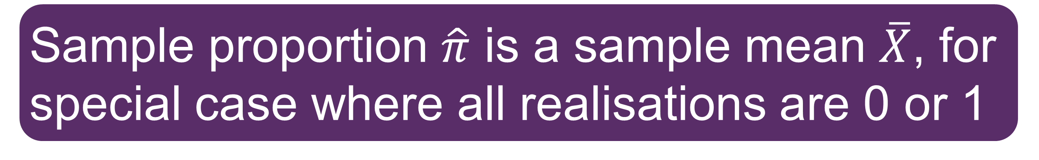
CIs For Sample Proportion
Sample proportion $\hat{π}$ is a sample mean $\overline{X}$, for special case where all realisations are 0 or 1

Slide 122
CIs For Sample Proportion
Sample proportion $\hat{π}$ is a sample mean $\overline{X}$, for special case where all realisations are 0 or 1
So CI formula we have already mostly works
$P\left(\overline{X}−\frac{z_{α/2}s}{\sqrt{n}}≤μ≤\overline{X}+\frac{z_{α/2}s}{\sqrt{n}}\right)≈$ $1−α$

Slide 123
CIs For Sample Proportion
Sample proportion $\hat{π}$ is a sample mean $\overline{X}$, for special case where all realisations are 0 or 1
So CI formula we have already mostly works
$P\left(\overline{X}−\frac{z_{α/2}(\hat{π}(1−\hat{π}))}{\sqrt{n}}≤μ≤\overline{X}+\frac{z_{α/2}(\hat{π}(1−\hat{π}))}{\sqrt{n}}\right)≈$ $1−α$

Slide 124
CIs For Sample Variance

Slide 125
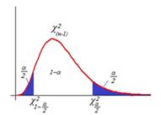
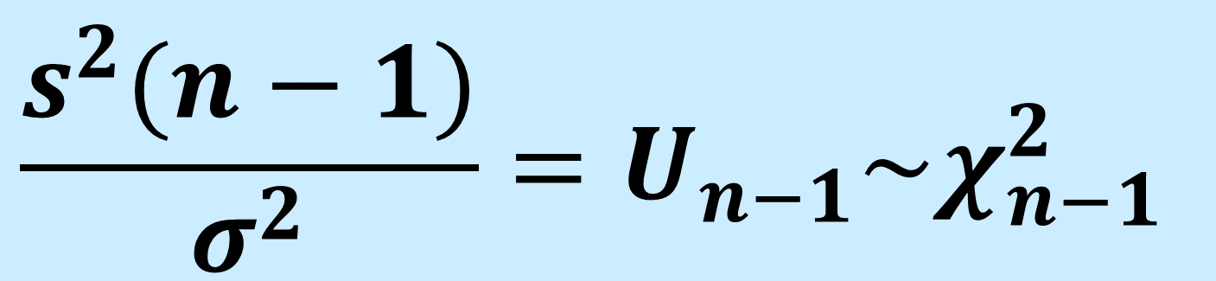
CIs For Sample Variance
Recall: From Video 4.1:
$$\frac{s^{2}(n−1)}{σ^{2}}=U_{n−1}\sim χ_{n−1}^{2}$$

Slide 126
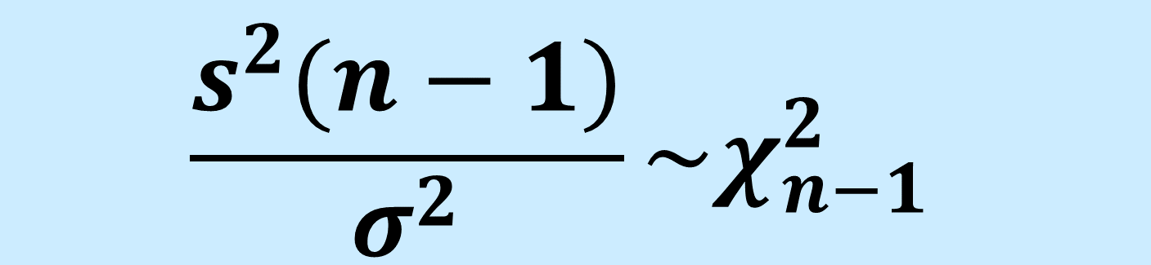
CIs For Sample Variance
Recall: From Video 4.1:
$$\frac{s^{2}(n−1)}{σ^{2}}\sim χ_{n−1}^{2}$$

Slide 127
CIs For Sample Variance

Slide 128
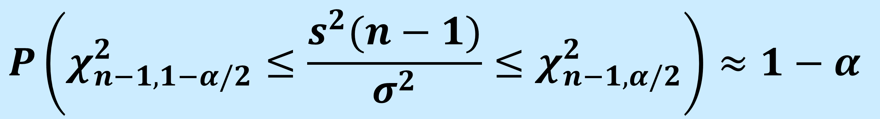
CIs For Sample Variance
$$P\left(χ_{n−1,1−α/2}^{2}≤\frac{s^{2}(n−1)}{σ^{2}}≤χ_{n−1,α/2}^{2}\right)≈1−α$$

Slide 129
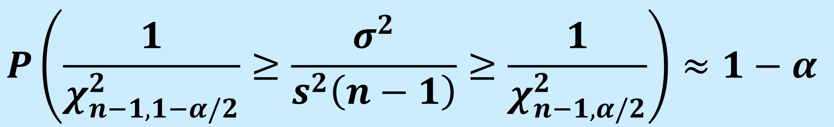
CIs For Sample Variance
$$P\left(χ_{n−1,1−α/2}^{2}≤\frac{s^{2}(n−1)}{σ^{2}}≤χ_{n−1,α/2}^{2}\right)≈1−α$$
$$P\left(\frac{1}{χ_{n−1,1−α/2}^{2}}≥\frac{σ^{2}}{s^{2}\left(n−1\right)}≥\frac{1}{χ_{n−1,α/2}^{2}}\right)≈1−α$$

Slide 130
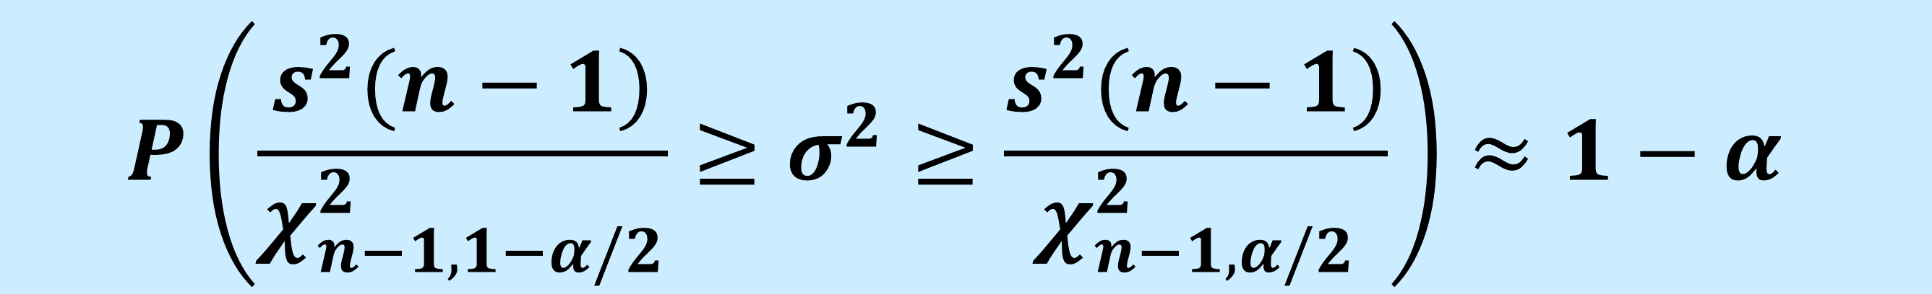
CIs For Sample Variance
$$P\left(χ_{n−1,1−α/2}^{2}≤\frac{s^{2}(n−1)}{σ^{2}}≤χ_{n−1,α/2}^{2}\right)≈1−α$$
$$P\left(\frac{1}{χ_{n−1,1−α/2}^{2}}≥\frac{σ^{2}}{s^{2}\left(n−1\right)}≥\frac{1}{χ_{n−1,α/2}^{2}}\right)≈1−α$$
$$P\left(\frac{s^{2}(n−1)}{χ_{n−1,1−α/2}^{2}}≥σ^{2}≥\frac{s^{2}(n−1)}{χ_{n−1,α/2}^{2}}\right)≈1−α$$

Slide 131
Example

Slide 132

Example
Let X be shop customers served per hour
E(X) = 448, Var(X) = 21
Sample size n = 35
Shop will be closed if X<440

Slide 133

Example
Agent finds $\overline{x}=442$

Slide 134

Example
Agent finds $\overline{x}=442$
Agent finds $s=20$

Slide 135

Example
Agent finds $\overline{x}=442$
Agent finds $s=20$
What is 95% CI for $μ?$

Slide 136

Example
$$\overline{x}=442$$

Slide 137

Example
$$\overline{x}=442$$
$$z_{0.025}=1.96$$

Slide 138
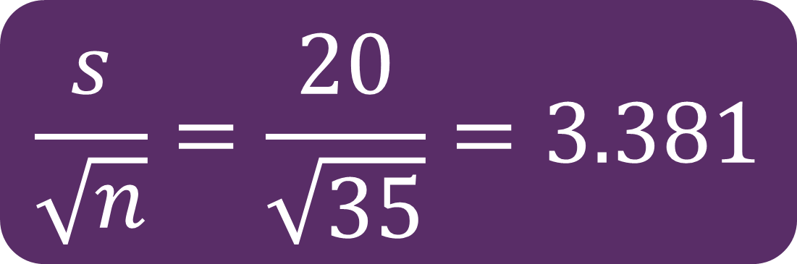
Example
$$\frac{s}{\sqrt{n}}=\frac{20}{\sqrt{35}}=3.381$$
$$\overline{x}=442$$
$$z_{0.025}=1.96$$

Slide 139
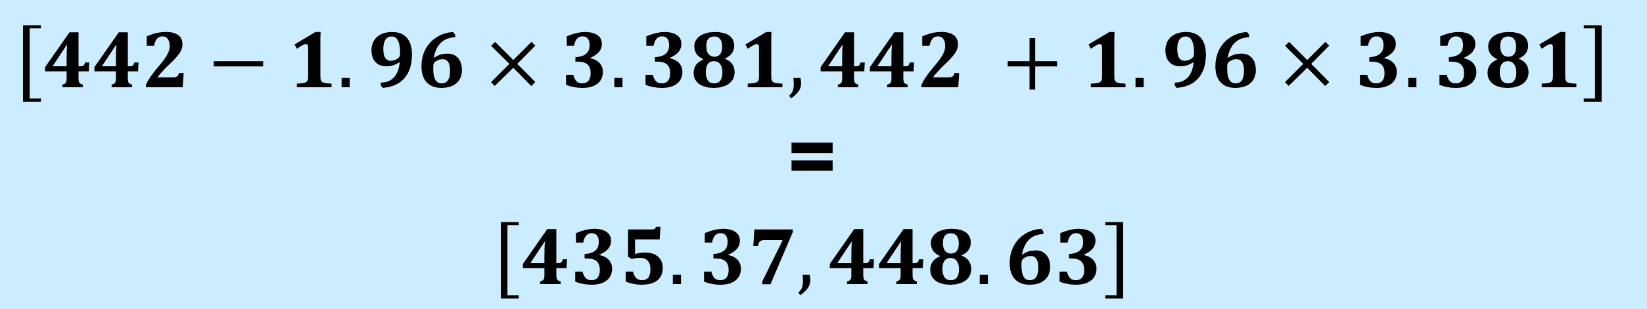
Example
$$\frac{s}{\sqrt{n}}=\frac{20}{\sqrt{35}}=3.381$$
$$\overline{x}=442$$
$$z_{0.025}=1.96$$
$$\left[442−1.96×3.381,442 +1.96×3.381\right]$$
=
$$\left[435.37,448.63\right]$$

Slide 140

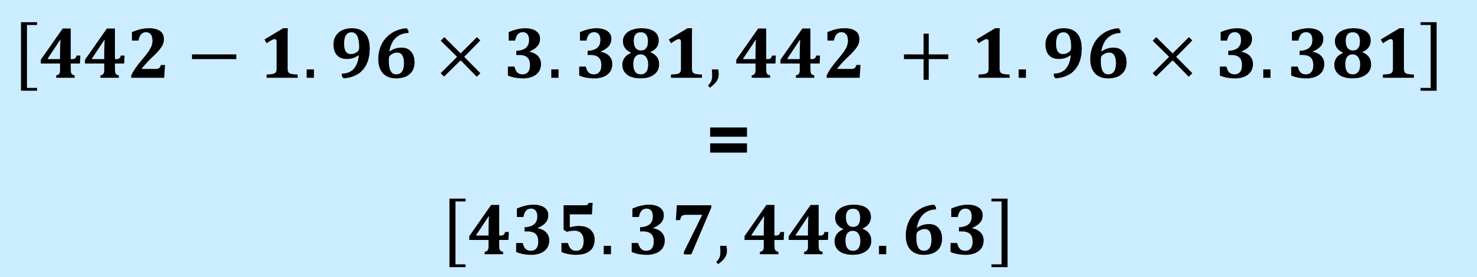
Example
$$\frac{s}{\sqrt{n}}=\frac{20}{\sqrt{35}}=3.381$$
$$\overline{x}=442$$
$$z_{0.025}=1.96$$
$$\left[442−1.96×3.381,442 +1.96×3.381\right]$$
=
$$\left[435.37,448.63\right]$$
We know $μ=448$, which is contained in CI

Slide 141
Next Time…

Slide 142
Next Time…
How do we test hypotheses using samples?

Slide 143
Questions?
Thank You!

